Slide 1
BCOG 100
Social Cognition
Lecture 1: The Evolution of Social Cognition in Primates

Slide 2
Reading Check 10-1
Password: ToM
Question: What is theory of mind, and what’s at least one way scientists have studied theory of mind
Notes:
Last time we examined earlier stages in evolution
and asked what new adaptive problems were created
as mammals changed their ecological strategies. This week we apply the same lens to the evolution of social cognition in primates
— not by starting with mechanisms, but by first identifying what needs to be explained.
Today we operate at the computational/functional level in Marr’s sense
— characterizing the problem that the lineage had to solve and the stable behavioral patterns that resulted. In Lecture 2 we will shift to the algorithmic level,
asking what kinds of representation and inference could, in principle, generate those patterns. In Lecture 3 we move to the implementational level,
asking how primate brains might instantiate those algorithms in actual circuits.
By the end of today, the explanandum will be defined. Only then do we try to explain how it could work.

Slide 3
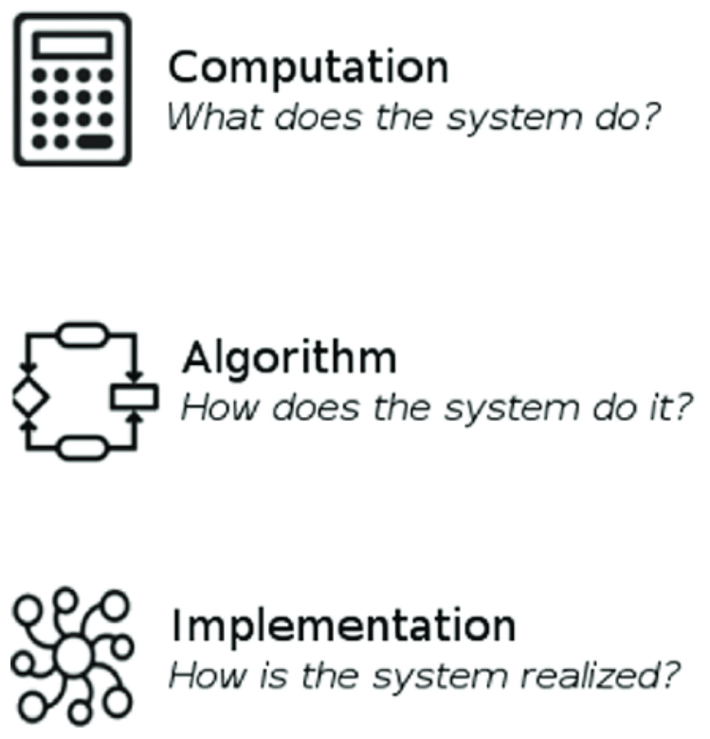
The Evolution of Social Cognition
Recap & Overview
Last Time:
The evolution of the neocortex, memory, and generative models in early mammals.
Today:
Some mammals start living in big, complex social groups
A lot of new behaviors and abilities emerged as a result
Notes:
Last time we examined earlier stages in evolution
and asked what new adaptive problems were created
as mammals changed their ecological strategies. This week we apply the same lens to the evolution of social cognition in primates
— not by starting with mechanisms, but by first identifying what needs to be explained.
Today we operate at the computational/functional level in Marr’s sense
— characterizing the problem that the lineage had to solve and the stable behavioral patterns that resulted. In Lecture 2 we will shift to the algorithmic level,
asking what kinds of representation and inference could, in principle, generate those patterns. In Lecture 3 we move to the implementational level,
asking how primate brains might instantiate those algorithms in actual circuits.
By the end of today, the explanandum will be defined. Only then do we try to explain how it could work.

Slide 4
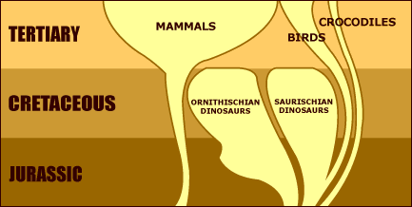
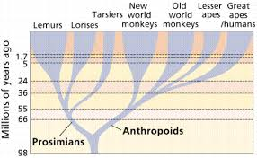
The Evolution of Social Cognition
Post-Dinosaur Extinction Context
After the dinosaur extinction (66 MYA) mammals diversified
Primates emerged in newly available arboreal niches
Behavioral evolution began on a new ecological stage
Notes:
After the Cretaceous–Paleogene extinction, large reptiles that had dominated many terrestrial niches disappeared.
Mammals, which had been evolutionarily constrained during the dinosaur era, underwent a rapid radiation into newly vacant roles.
Some lineages moved into trees, some onto open plains, some into nocturnal predator niches.
The primate lineage emerged within this ecological reshuffling,
inheriting a world in which old constraints were gone and new possibilities existed.
This means that the behaviors we will eventually try to explain
did not evolve under the same conditions that shaped earlier mammalian strategies.
They emerged in a world where new resources, new risks, and new spatial constraints were in play.
The extinction event itself does not explain any primate trait directly.
But it created the ecological frame in which primate evolution unfolded,
shifting which strategies were profitable and what kinds of cognitive demands became relevant.
Everything that follows sits downstream of that environmental reset.

Slide 5
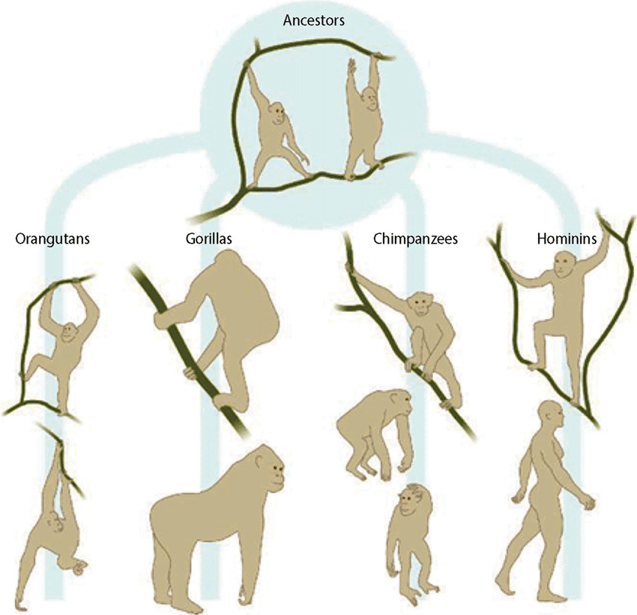
The Evolution of Social Cognition
Arboreal Constraints
Life occurred in a three-dimensional canopy
Falls and footing failures were lethal
Movement required spatial foresight
Notes:
Moving through trees forced animals to plan actions before executing them.
A primate had to know which branch would hold its weight, where it could land safely, and how to pivot if a predator appeared.
Instantaneous reaction was often too late; success depended on modeling the structure ahead of time.
Predators in the canopy could attack from angles unavailable on the ground,
and escape options were channeled into narrow pathways.
This made foresight a survival trait long before social complexity entered the picture.
Individuals that anticipated the environment outlived those that merely reacted to it.
Tree life also altered navigation.
Primates reused stable routes, avoided past hazards,
and coordinated movement in ways that relied on stored spatial information.
This embedded the idea — seen across many of the examples today
— that representation of non-present information became adaptively valuable.

Slide 6
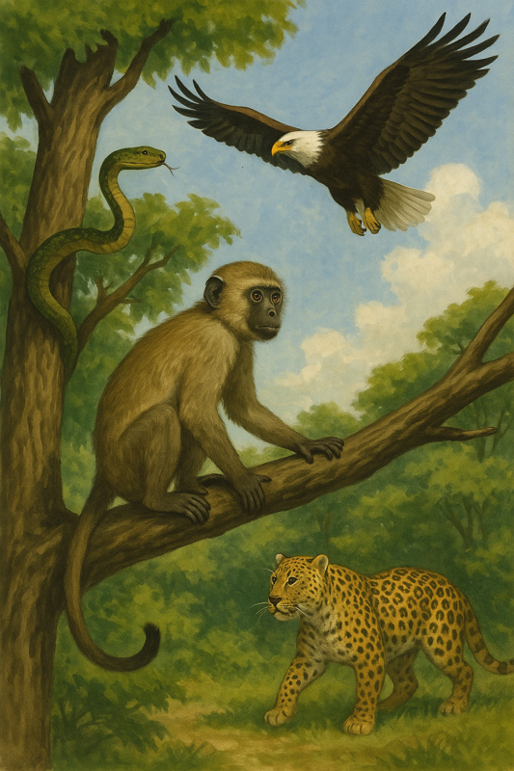
The Evolution of Social Cognition
Predator and Risk Structure
Predators shaped grouping and vigilance patterns
Safety depended on others’ presence
Risk was uneven across space and time
Notes:
Arboreal primates did not face uniform danger.
Predators could appear from above, below, or at constricted crossings in the canopy.
Some positions in a group were safer than others, and some times of day were more dangerous than others.
Living near others reduced individual vigilance demands and provided early warning.
But movement constraints in the trees prevented large groups
from flowing as a single unit the way herds do on open ground.
Safety depended not just on numbers but on who was nearby and what alternative paths existed.
This meant individuals lived under conditions of structured risk, not randomness.
Threat exposure could vary systematically with position, subgroup composition, and travel route.
That structure mattered because success required anticipating risk ahead of time, not just reacting once danger appeared.
Such structured risk contexts set the stage for later social strategies
— not because those strategies existed yet,
but because the environment made non-reflexive decision-making adaptive.

Slide 7
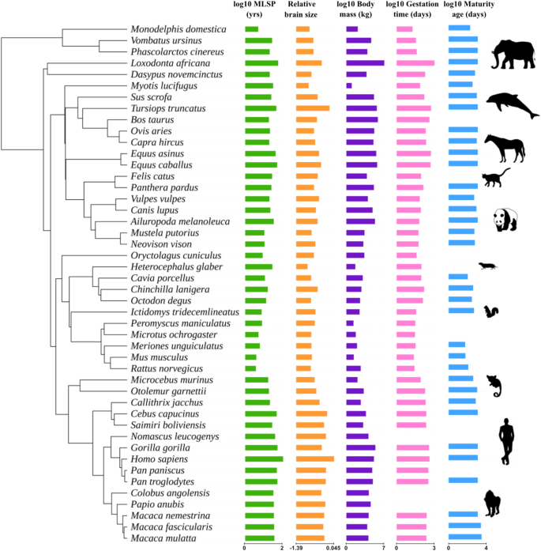
The Evolution of Social Cognition
Slow Life Histories and High Cost of Error
Primates lived long lives for their body size
They produced few offspring with heavy investment
Errors had consequences across years
Notes:
Unlike many mammals, primates reproduced slowly and invested intensively in each infant.
Because offspring were few, each survival outcome mattered disproportionately.
A mistake in learning or social placement could reduce decades of potential reproduction.
Long lives meant long memory and long exposure to the same individuals.
A decision made in year three could still matter in year ten when alliances, offspring, or resource access shifted.
This stretched the horizon of what counted as a “cost” or “benefit.”
A long juvenile period provided time to acquire patterns of behavior by exposure and rehearsal in a low-stakes phase.
But it also meant many years of accumulating interactions that could not be undone.
Under these conditions, behavior had to be calibrated to futures, not merely to presents.

Slide 8
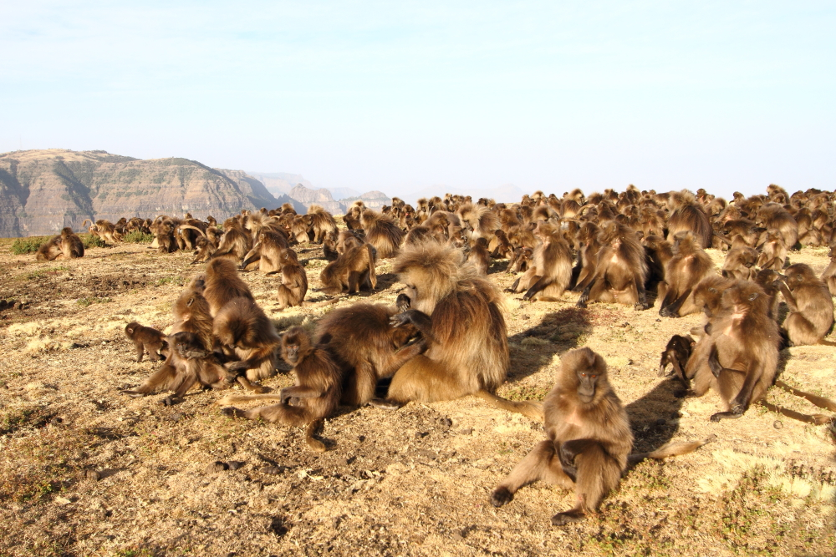
The Evolution of Social Cognition
Stable Groups Under Fission–Fusion Constraints
Groups persisted over years, not hours
But subgroups split and rejoin due to travel limits
Individuals often acted on partial information
Notes:
Primate groups were stable in membership across years,
creating repeated interaction with the same partners, rivals, and observers.
This stability meant that history mattered — one did not start fresh each day with new strangers.
But travel in a complex canopy prevented the entire group from moving as a single unit.
Subgroups frequently split and later reunited,
so no individual had continuous access to what others were doing or deciding.
When subgroups merged again, interactions resumed where they left off, as if memory bridged the gap.
This created a world in which decisions were made despite missing or outdated social information.
It is crucial to note: this is still context, not behavior.
We are describing the informational structure of the environment
that made new behavioral solutions necessary later, not the solutions themselves.

Slide 9
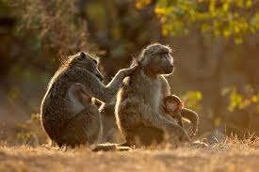
The Evolution of Social Cognition
Managing Conflict Without Constant Fighting
Physical aggression is costly and risky
Primates use signals and rituals to defuse tension
Reconciliation repairs relationships after disputes
Notes:
Fighting carries injury risks and long-term social costs, so primates rarely resolve every dispute with force.
Instead, they use threat displays, facial signals, and ritualized postures to establish outcomes without escalation.
These signals allow groups to remain stable even when interests conflict.
After aggression does occur, many primates engage in reconciliation behaviors.
Former opponents may groom, embrace, or sit in contact shortly after a fight, reducing the risk of retaliation or long-term estrangement.
This type of “social repair” behavior has been documented in macaques, baboons, and chimpanzees.
Conflict management of this kind implies that individuals track not only whether a fight occurred, but whether it has been resolved.
Actions are taken not just to win the moment but to preserve or restore a valuable relationship over time.
This marks a shift from immediate payoff behavior toward behavior calibrated to long-term social stability.

Slide 10
The Evolution of Social Cognition
From Social Structure to Behavioral Demands
Context created demands for prediction and long-term reasoning
Nothing here explains the behaviors — it explains why they were needed
Next we shift to the behavioral phenomena that emerged
Ecological Context | Behavioral Consequences
life in the trees eating fruit variable predators long life large semi-stable groups | ?
Notes:
Stable, long-lived primate groups created conditions in which
individuals repeatedly faced the same allies, competitors, and observers across years.
Rank and coalitions did not simply exist as background;
they were maintained, challenged, and revised through behavior that unfolded over long time scales.
Every decision was made against a remembered backdrop of past aid, betrayal, tolerance, or threat.
In such a world, behavior could not be reflexive or short-sighted.
Individuals had to act in ways that preserved future alliances,
avoided accumulating enemies, and positioned themselves for later advantage.
Social life became not a sequence of isolated events but a linked chain in which each move altered later possibilities.
What follows in the next set of slides are the specific kinds of behaviors that emerged under these conditions
— behaviors that cannot be explained by present stimuli alone.
Those behaviors form the explanandum of this lecture.
The question of how they are implemented cognitively will be reserved for Lecture 2.

Slide 11
The Evolution of Social Cognition
Evolutionary Node | Approx. Date | Best Estimate of Brain Volume
Mammal–Reptile Common Ancestor | ~300–320 Mya | ~1–3 mL
Mammal Common Ancestor | ~180–200 Mya | ~2–5 mL
Primate Common Ancestor | ~55–65 Mya | ~10–15 mL
Ape Common Ancestor | ~15–20 Mya | ~300–350 mL
Modern Human | present | ~1350 mL
1. The Primate Brain Got Much Bigger
Primates evolved brains far larger than expected for body size
This enlargement co-occurred with the new behavioral profile
Bigger brains appeared before we know how they were used
Notes:
Relative to other mammals of similar mass, primates
— and especially great apes — showed a dramatic increase in brain volume over evolutionary time.
This change did not occur in isolation: it emerged alongside the shift to long-lived social groups,
time-sensitive foraging, and future-dependent interaction patterns.
Brain expansion is therefore part of the same cluster of changes we are trying to explain, not an alternative to them.
Crucially, the size increase does not itself tell us which computations those brains performed or why larger brains were favored.
At this point in the narrative, the enlargement is simply a fact to be explained,
on the same footing as cooperation beyond kin, delayed payoffs, and transmitted traditions.
It is not evidence for any particular theory of cognition
— only evidence that the lineage changed in a way not predicted by prior mammalian baselines.
By placing brain size here — after the context and before the mechanisms
— we make clear what its role is in our logic.
It is not a cause we assume nor an explanation we rely on;
it is one of the explananda that any adequate account must eventually make sense of
when we turn to algorithmic and neural levels in later lectures.

Slide 12
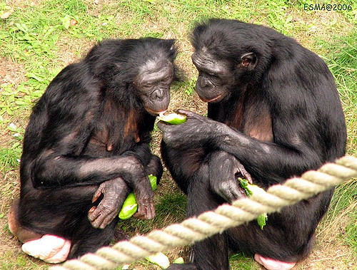
The Evolution of Social Cognition
2. Cooperation Beyond Kin
Primates cooperated with non-relatives
They formed and maintained alliances with no shared genes
This created benefits that could not be reduced to kinship
Notes:
Many primates exchanged favors, tolerated access to food, supported others in conflicts,
and defended unrelated group members against outsiders.
For example, in baboons, unrelated males have been observed forming coalitions to displace a dominant male,
then later supporting each other in future contests even when immediate gain was not guaranteed.
These episodes did not occur randomly; they involved consistent, repeated coordination across time
between individuals with no genetic stake in one another’s reproduction.
This is not what a simple kin-selection story would predict.
Kin selection can explain helping relatives because genes benefit indirectly
— but helping unrelated individuals has no such built-in genetic rebate.
Yet this pattern is widespread in primates, stable over years, and consequential for reproductive success and survival.
That makes it a genuine explanandum:
not that cooperation occurs in principle — many species cooperate —
but that primates routinely sustained structured cooperation with non-kin
despite delayed, uncertain, and indirect payoff,
which requires an explanation beyond immediate genetic advantage.

Slide 13
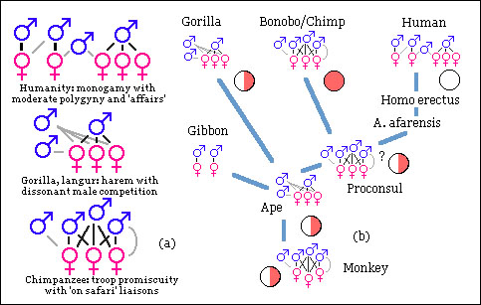
The Evolution of Social Cognition
3. Stable Social Hierarchies as a Behavioral Regularity
Primates organized themselves into patterned rank structures
Rank predicted access to resources, space, allies, and safety
Hierarchies were long-lived and tracked by all group members
Notes:
In many primate societies, individuals occupy enduring social ranks that shape who yields and who displaces,
who receives tolerance and who is excluded, and who gains support in conflicts.
These structures are not transient — they persist over months or years
and are treated by group members as known facts about the social world.
Sex-specific forms of hierarchy appear in many species.
In baboons and macaques, for example, female rank is often inherited through matrilines,
producing stable female-dominated dominance orders,
while male rank is often negotiated through coalitions, age, or immigration.
In chimpanzees and some other apes, male status hierarchies are especially salient for aggression and mating,
while females maintain structured relationships that regulate access to space, safety, and infant handling.
The important point for this lecture is not the mechanism that creates hierarchy, but the behavioral regularity:
primates behave as if social rank is a durable property that all group members track and use to guide action.
That hierarchical organization itself is one of the explananda we will ultimately need to account for in later lectures.

Slide 14
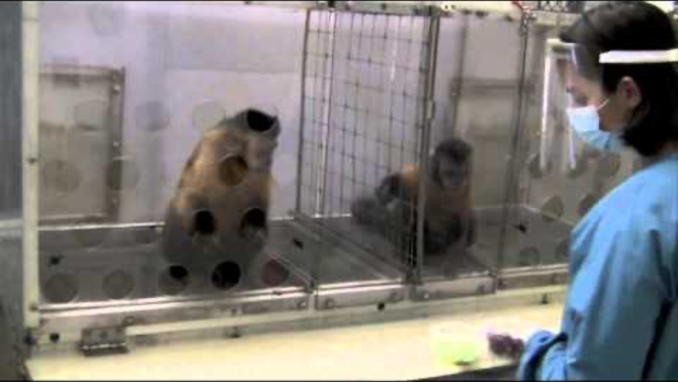
The Evolution of Social Cognition
4. Fairness-Like Responses and Norm Sensitivity
Primates protest unequal outcomes
Third parties sometimes react to violations
Behavior suggests implicit expectations
Notes:
In stable primate groups, individuals do not just care about what they receive
— they care about how they receive it relative to others.
Because the same partners will be encountered again tomorrow,
a pattern of being treated worse than a peer has long-term consequences for status,
bargaining power, and future cooperation.
This makes the terms of exchange, not just the outcome, behaviorally relevant.
In the well-known Brosnan & de Waal experiment, two capuchins exchanged tokens for food.
Both accepted cucumber slices until the experimenter gave the partner a grape for the same task.
The first monkey stared, then threw the cucumber back, pounded the table, and refused to continue
— sacrificing its own reward to reject a bad deal.
Similar protests occur in chimpanzees when one monopolizes meat after others helped secure it,
and in some cases bystanders react to inequity even when they are not the ones losing out.
Outside primates, corvids and dogs show partial analogs,
but typically without the same embedding in long-term social relationships.
These reactions are costly in the moment, which means they are not reflexive frustration responses.
They function to protect future bargaining position and to discourage exploitative patterns
that would otherwise persist in a stable group.
This is norm-like behavior anchored in expectations formed across repeated interactions,
not a one-shot reaction to current stimuli.

Slide 15
The Evolution of Social Cognition
5. Long-Horizon Planning and Deferred Payoff Behavior
Decisions depended on future, not just present
Actions were taken in expectation of later states
Payoffs often arrived with delay
Notes:
Across many primate species, individuals have been observed forgoing immediate rewards,
maintaining tolerant relationships,
or refraining from aggression in ways that only made sense when viewed months or years later.
For example, female vervet monkeys have been documented sharing access to high-value food with non-kin females,
who later became crucial supporters during disputes over infant handling or territory access.
Similarly, subordinates in both sexes of macaques
sometimes persist in grooming higher-rank individuals without immediate reciprocation,
later receiving coalition support or safe spatial access when tensions escalate.
These patterns are not reducible to instinctual reflex or one-shot exchange.
They imply that actions were taken with reference to expected future states
— alliances that might be needed later, debts that might be repaid,
or conflicts that had not yet occurred.
What made the behavior adaptive existed in the future, not the moment of action.
This makes long-horizon coordination itself an explanandum.
It reflects a lineage in which the future exerted causal force over present behavior,
meaning organisms behaved as if carrying internal representations of outcomes not yet encountered
— a phenomenon that requires further explanation in later lectures.

Slide 16
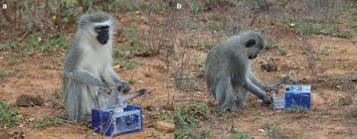
The Evolution of Social Cognition
6. Cultural Transmission and Group-Specific Traditions
Groups differed in stable behavioral practices
Juveniles acquired local customs over years
Traditions persisted across generations
Notes:
Across primate species, neighboring groups living in the same habitat often behave differently in systematic ways.
Chimpanzees in one forest crack nuts with stones while a nearby group never does,
despite access to the same nuts and stones.
Differences like grooming styles, courtship displays,
or foraging tricks persist within groups and remain absent in others.
These are not one-off tricks but stable traditions that juveniles acquire by growing up inside a particular social group.
Young chimpanzees in nut-cracking communities watch adults for months or years before attempting the technique.
In groups without cracking, juveniles never spontaneously invent the behavior in adulthood.
Partial analogs appear in some birds and dolphins,
but primate traditions span multiple behavioral domains and are woven into long-term social life.
Transmission does not require teaching in a human sense;
it arises because individuals live long enough, return to the same social relationships,
and have repeated exposure to competent models.
The key point is that groups accumulate and preserve behavioral structure that outlives individuals.
What one learns depends not only on species-wide biology but on local social history.
This is culture in the behavioral sense — enduring, socially inherited variation within a species.

Slide 17
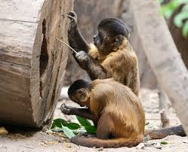
The Evolution of Social Cognition
7. Tool Use and Socially Mediated Skill Acquisition
Some primates use tools routinely
Tools are learned socially, not reinvented each time
Complex techniques accumulate within groups
Notes:
In several primate species, individuals use sticks to extract termites,
leaves as sponges to soak up water, or stones to crack nuts.
These behaviors involve multi-step sequences that are not innately specified
and are rarely invented from scratch by isolated individuals.
Juveniles acquire these techniques only after prolonged exposure to skilled adults
and then reproduce the behavioral sequence themselves.
Among chimpanzees, young apes watch nut-cracking sessions for months or years,
beginning with clumsy attempts and gradually refining the technique.
In termite fishing, mothers sometimes slow their own actions to allow infants to handle the tool mid-sequence,
creating structured opportunities to acquire the pattern.
In some orangutan populations,
tool use spreads outward through cohorts as individuals adopt procedures seen in peers.
Outside primates, objects are used by some corvids and sea otters,
but in primates tool use is often embedded in social transmission and group tradition
rather than isolated innovation.
What matters is not a single clever act but the maintenance and spread of procedures across time.
Tool use of this kind shows that primates did not merely react to their environment
— they constructed solutions and passed them on as lasting behavioral lineages.

Slide 18
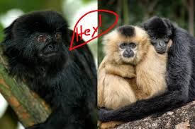
The Evolution of Social Cognition
8. Behavior Appearing to Reflect Internal Emotional Regulation
Primate behavior changed systematically after social events
These changes reduced future cost or secured future support
We observe the pattern, not the internal cause
Notes:
Many primate behaviors unfold as if shaped by internal states such as jealousy, anxiety,
or relationship repair, but what we directly observe is the structured sequence of actions over time.
For example, when a female chimpanzee’s long-term grooming partner begins grooming a rival,
she may intervene, displace one of them, and subsequently seek renewed grooming from the partner
— a pattern that only makes sense if the relationship carries deferred value.
Similarly, in macaques, former opponents often reconcile soon after a fight: they groom, embrace, or sit in contact,
and reconciled pairs are less likely to resume aggression later.
The behavior functions as if some “repair motive” were active,
but empirically what we see is a behavior that preserves a future-support relationship at present cost.
Researchers debate whether to label such cases “jealousy,” “attachment,” “anxiety,” or to avoid emotional terms altogether.
The safer claim is that primates alter behavior in ways that reduce future social cost or secure future backing,
even when such actions do not yield an immediate payoff.
Analogous cases exist outside primates, such as elephants consoling distressed group-mates,
but in primates these response patterns occur within a dense web of stable, repeated partnerships.
Whether or not a species has a “feeling” in the human sense,
the behavior serves a long-horizon regulatory function inside a durable social network.

Slide 19
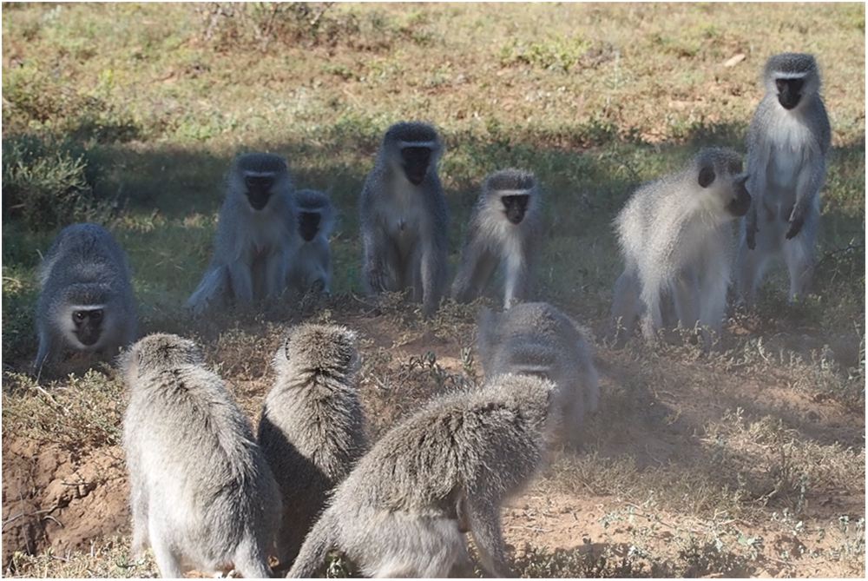
The Evolution of Social Cognition
9. Ingroup–Outgroup Differentiation
Primates treated group members and outsiders differently in systematic ways
The same individual could receive protection or aggression depending on category
Behavior was organized by membership, not only by personal history
Notes:
Many primate societies showed strong in-group tolerance paired with hostility or suspicion toward outsiders.
Chimpanzees patrolled territorial borders and sometimes attacked lone intruders,
while within the group they shared food, groomed, and coordinated defense.
The same animal that was defended when “one of us” could be attacked when “one of them.”
To behave this way, individuals had to classify others — recognizing who belongs and who does not.
They learned faces, voices, locations, and histories,
and linked those perceptual cues to group identity in ways
that shaped responses before any one-to-one interaction occurred.
Once classification of conspecifics existed,
it provided the raw material for more abstract social group categories.
This creates a natural bridge to Lecture 2.
General-purpose mechanisms for pattern recognition and category formation
— the same kinds used to distinguish foods or tools
— could be repurposed to classify individual animals and entire groups.
Whether this later produced cooperation and loyalty or prejudice and exclusion,
the behavioral fact for Lecture 1 is this:
primates acted on learned social categories, not only on immediate experience,
and this fact now requires explanation at the algorithmic and neural levels.

Slide 20
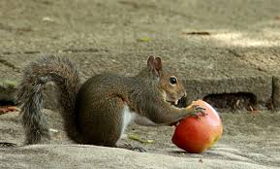
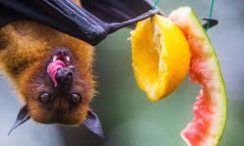
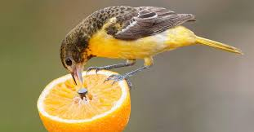
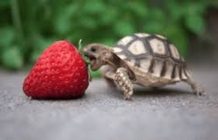
The Evolution of Social Cognition
Partial Parallels in Other Species (and Why They Matter Here)
Some non-primates show fragments of these behaviors
No single factor (fruit, sociality, tools) is uniquely primate
Comparisons prevent oversimplified causal stories
Notes:
Before moving toward explanation,
it is important to check whether the behavioral features we just reviewed are truly unique to primates.
They are not. Corvids cache food and remember who pilfered;
dolphins form long-term male alliances; elephants reconcile after conflict;
and even ants live in vast cooperative societies.
Pieces of the primate pattern appear elsewhere in the animal kingdom.
However, these cases generally express one or two components in isolation
— tool use without coalitions, coalitions without culture, or social structure without foresight.
What distinguishes primates is not the presence of one ingredient,
but the co-occurrence and integration of many of them in the same lineage under the same life-history conditions.
This prevents us from using a single variable — “big groups,” “fruit diet,” “tool use” — as the sole explanation.
This transition matters for the logic of the course.
We have now finished describing what must be explained: a suite of behavioral regularities that emerge together in primates.
From this point onward we will shift from cataloguing phenomena to asking what could possibly generate them without assuming the answer in advance.

Slide 21
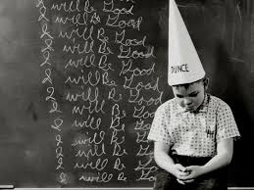
The Evolution of Social Cognition
Why the Parallels Do Not Defeat the Puzzle
Having a fragment ≠ having the full syndrome
Correlation does not imply the same causes
We must guard against simple “X ⇒ big brain” claims
Notes:
The existence of partial analogs in other species might seem, at first glance,
to undermine the need for an explanation in primates.
But a dolphin coalition without tool traditions is not the same phenomenon
as a chimpanzee coalition embedded in multi-generational cultural practices.
Likewise, a crow solving a puzzle in isolation is not the same as a juvenile learning tools inside a stable,
history-rich social network.
Convergent examples tell us only that certain behaviors can evolve under some conditions;
they do not tell us that the same pressures or same mechanisms produced them in each case.
We cannot infer that because ants are social and humans are social, “sociality causes big brains,”
or that because otters use tools and apes use tools, “tool use causes culture.”
This is the point in the narrative at which naive causal shortcuts often creep in:
“Large groups cause intelligence,” or “Fruit drives brain growth,” or “Tool use explains everything.”
The comparative evidence forces us to reject such one-factor explanations
and to treat the primate case as a composite evolutionary problem still in need of a functional account.

Slide 22
The Evolution of Social Cognition
Summary
Observed a suite of primate behaviors needing explanation
Identified ecological and social conditions under which they arose
Next Time
Lecture 2: consider what internal algorithms and representations could produce such behavior.
Lecture 3: How the primate brain changed, and how it might implement some of these processes
Notes:
The behavioral evidence reviewed so far points to a world
in which success depended on anticipating what others would do and what the environment would become,
not merely reacting to what was true now.
Individuals behaved as though past interactions, likely futures, and social categories informed their choices
— even when those states were not directly observable.
The explanandum of this module is therefore not brain size or “intelligence” in the abstract,
but the pattern of behavior that seems to require non-present information to guide action.
Such behavior is unlikely to emerge from reflex alone.
To act as if the future matters, as if reputations persist, as if coalitions have latent value,
and as if categories constrain behavior, something must organize action around more than current stimuli.
The question we now carry forward is: what internal functional organization could generate behavior of this kind?
This closes the descriptive phase of Lecture 1.
Lecture 2 will take up the problem at the algorithmic level — not yet asking where in the brain this happens,
but what kind of representational and inferential machinery could, in principle,
produce these behavioral regularities without assuming the answer in advance.

